Slide 1
Strategic Marketing Simulator 1.0 Sprint 4 review
Strategic Marketing Simulator 1.0
Team # 15
Team Members
Jeffrey Carman
Javier Andrial
Product Owner: Joseph Cilli
Project Mentor: Masoud Sadjadi

Slide 2
Introduction – What is Strategic Market Simulator
Strategic Market Simulator
An online website for simulating running an Hotel. Their decisions will affect how well their hotel runs as well, as having affects on other hotels by reducing their business.
Game
Hotel
Student
Periods

Slide 3
Responsibilities
Responsibilities this Sprint
News Page
Admin
Select different Games
Select a Period for a Game
Enter in a News Article for a Period/Game
Preview Article
Commit Article to Database
Add Affect Parameters for a News Article
Commit Parameters to Database
Student
View News for their
Game
Current Period

Slide 4
Live Demonstration
Choosing a Game
Writing and Previewing an Article
Adding and Removing Parameters
Choosing/Changing a Period
Student View
Committing the News Article to Database

Slide 5
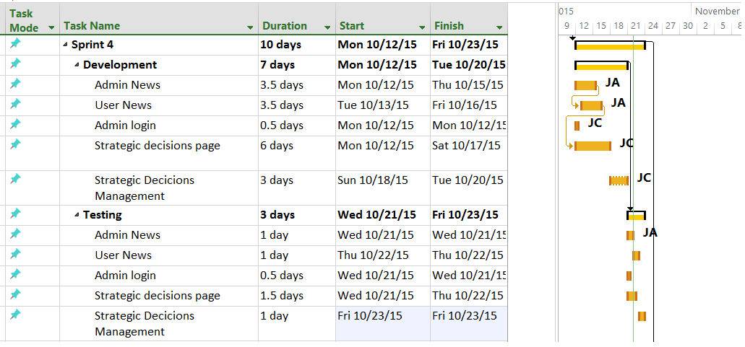
Sprint Schedule

Slide 6
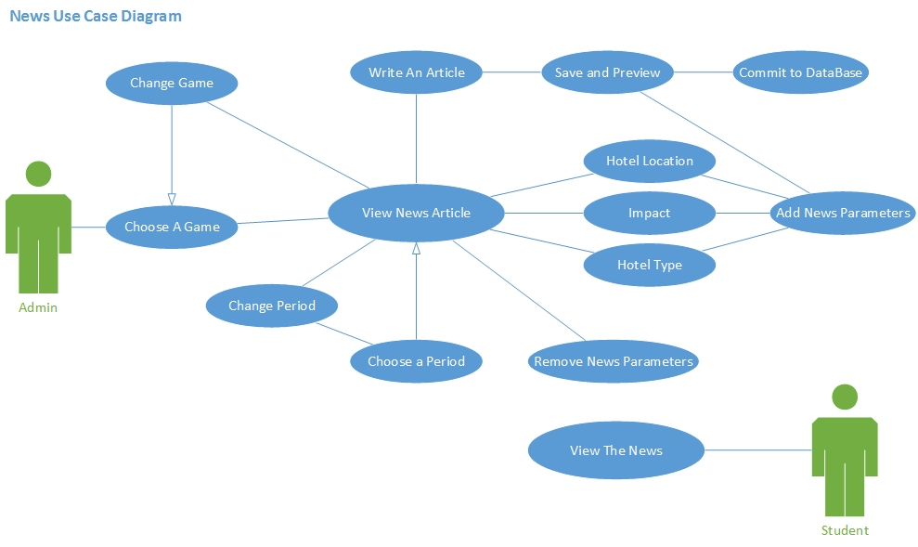
Use Cases Modeling

Slide 7
User Stories
User Story #800 – Admin News Management
Admin is able to write or paste a News Article for a period, for a game.
the Admin is able to apply News Parameters to an article. these Parameters apply an affect to specific Hotels for that Period, in a Game.
Administrators can Choose which Game to Views the News for.
Administrators can Choose Which Period in a Game to view/Modify the News for.
Administrator can Save their changes to the Database or erase everything and start over.
Tasks
Add methods to Database class to create and return arrays of entries.
Allow Admin to Choose a Game and a Period
Admin can save an Article and affect parameters for a Game’s Period
Admin can remove/change saved content
Appropriately display News Article HTML upon preview

Slide 8
User Stories
User Story #679 – User View News
As a logged in user I need to be able to click on the "news" link to view current events so that I can make an informed decision about how to allocate my marketing budget
user clicks on the news button.
The system navigates to the new pages
News articles are listed
Tasks
Confirm Student Session
Display the News article for that Users Game for its Current Period

Slide 9
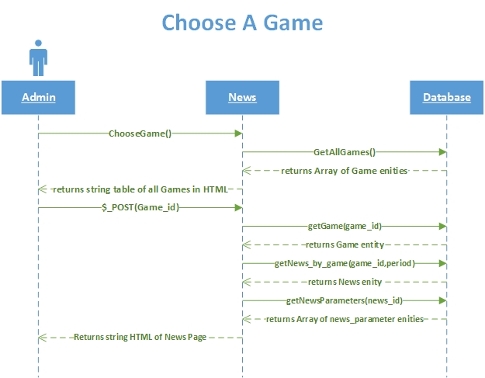
Sequence Diagrams

Slide 10
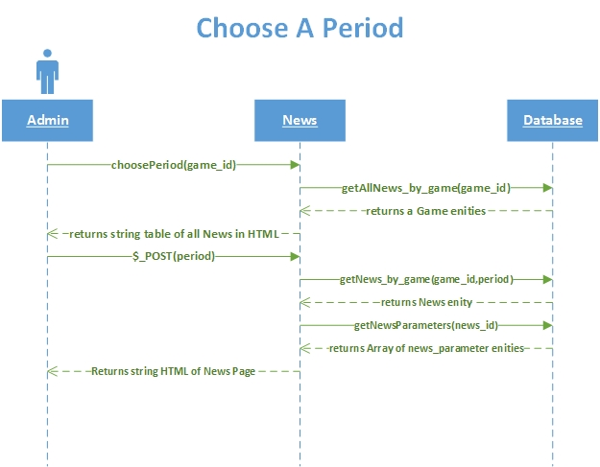
Sequence Diagrams

Slide 11
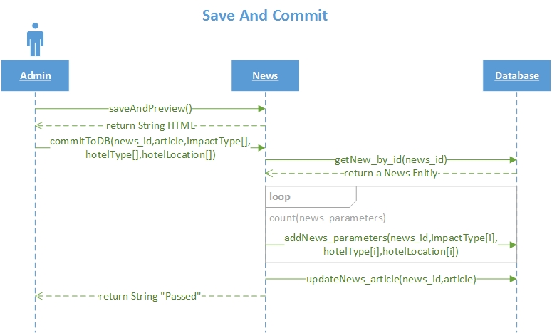
Sequence Diagrams

Slide 12
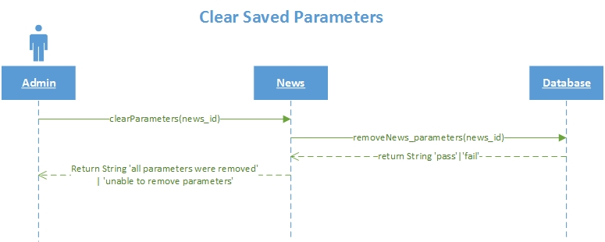
Sequence Diagrams

Slide 13
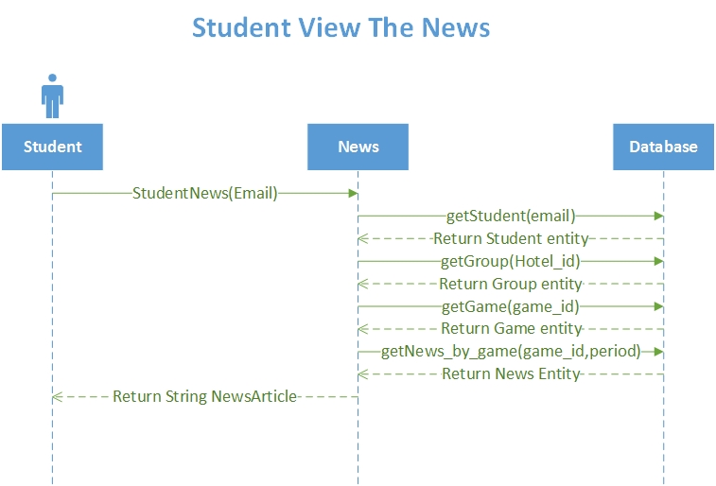
Sequence Diagrams

Slide 14
Software Testing
PHPUnit 4.8.9 by Sebastian Bergmann and contributors. Runtime: PHP 5.5.9-1ubuntu4.11Configuration: /srv/marketsim/www/Tests/phpunit.xml
NewsController
ok - NewsControllerTest::test__constructInvalidPar
ok - NewsControllerTest::test__construcValidPar
ok - NewsControllerTest::test_CreatePage
ok - NewsControllerTest::test_clearParameters
ok - NewsControllerTest::test_getArticle
ok - NewsControllerTest::test_getGamePeriod
ok - NewsControllerTest::test_getNewsPeriod
ok - NewsControllerTest::test_getNews_id
ok - NewsControllerTest::test_getTable
ok - NewsControllerTest::test_chooseGame
ok - NewsControllerTest::test_student_news
ok - NewsControllerTest::test_addPeriod
ok - NewsControllerTest::test_removePeriod
ok - NewsControllerTest::test_choosePeriod
ok - NewsControllerTest::test_CreatePage_admin
Database
ok - databaseTest::test_updateNews _article
ok - databaseTest::test_AddNews_parameters
ok - databaseTest::test_getNews_by_game
ok - databaseTest::test_getNews_by_id
ok - databaseTest::test_getAllNews _by_game
ok - databaseTest::test_getAllNews_parameters
ok - databaseTest::test_AddNews
ok - databaseTest::test_removeNews_parameters
ok - databaseTest::test_removeNews
ok - databaseTest::test_getLocationByType
ok - databaseTest::test_addGame_period
ok - databaseTest::test_getGame_period
ok - databaseTest::test_updateGame_period

Slide 15
Test Case
Test ID: | NewsControllercreateGamePageTest42
Description: | Test database function chooseGame with valid input
Test Steps | Step 1: Create NewsController object $a
 | Step 2:"<div class='' align='left'>". "<h2>News</h2>". "<h3>Course Number</h3>". "<input type = 'text' name = 'textbox_courseNumber' pattern='[0-9]{5}' placeholder = '88529' title='5 digit number'>". "<h3>Course ID</h3>". "<input type = 'text' name = 'textbox_courseID' placeholder = 'MAR2015'>". "<h3>Section</h3>". "<input type = 'text' name = 'textbox_section' placeholder='U02'>". "<h3>Semester of Game</h3>". "<input type = 'text' name = 'textbox_semester' placeholder='FALL 2016'>". "<h3>Course Meeting time</h3>". "<input type = 'text' name = 'textbox_schedule' placeholder='mwf 12pm-1:30pm'>". "<br />". "<br />"."<br />". "<input name='button_ChooseGame' type = 'submit' value = ‘Choose Game' class='btnbtn-primary'/>". "</div>"
 | Step 3: assertEquals($a->chooseGame (), $result)
Tester: | Javier Andrial
Result: | Pass

Slide 16
Strategic Marketing Simulator 1.0 Sprint 4 review
Strategic Marketing Simulator 1.0
Team # 15
Team Members
Jeffrey Carman
Javier Andrial
Product Owner: Joseph Cilli
Project Mentor: Masoud Sadjadi

Slide 17
Sprint Schedule

Slide 18
Sprint 4 Stories – A summary
User story #704: Admin login
User story #676 User home (unfinished)
User story #679 User view news
User story #800 Admin News Management
User story #810 Admin Strategic decisions
User story #678 User strategic decisions

Slide 19
User stories
User Story # 704 - Admin Login
As an admin I need to be able to log into the system so that I can manage games and users
An admin navigates to the login page.
An admin enters his username and password into the corresponding text boxes
Tasks
Create admin check at login with session
Create admin session and redirects for all pages.
Acceptance Criteria
A user has an admin account with valid credentials

Slide 20
User stories
User Story # 678- User strategic decisions
As a logged in user, I need to be able to click on "Strategic Decisions" link from the toolbar so that I can assign values to the budgetary items: Marketing personnel, advertising media, room pricing, and third party vendors
A user clicks on the strategic decisions link.
System navigates to strategic decisions page.
Tasks
jQuery frontend balance update
Marketing personnel column
Update database functions
Advertising column
Strategic decisions page
Market Segment column

Slide 21
User stories
User Story # 810- Admin strategic decisions management
As a logged in admin , I need to be able to click on "Strategic Decisions" link from the toolbar so that I can assign values and impacts to budgetary items: Marketing personnel, advertising media, room pricing, and third party vendors
Tasks
Create Strategic Decisions Manage Page
Update database with functions
Acceptance Criteria
An admin is logged in
Admin clicks on strategic decisions link.

Slide 22
Scenarios
Scenario 22 Admin login
Professor Johnson began teaching a marketing class last semester and would like to use the Strategic Marketing Simulator. He was given access by another professor that used it during the summer. Professor Johnson uses his internet browser to navigate to http://Marteksim.com. the website redirects him to the login page, where he enters his username and password and clicks the login button. Professor Johnson is logged into the system.

Slide 23
Scenarios
Scenario 16 Strategic Decisions
Sarah is the group leader for her group “ABC Marketing” and as such, she is responsible for selecting all the strategic decisions for her team after a discussion and analysis of their progress. Sarah ticks the City Bus Ads”, “Promotional Gifts” and “TV spots” check boxes, enters an average daily rate for rooms as “$68” and clicks the “select decisions “ button. Sarah is redirected to her home page.

Slide 24
Scenarios
Scenario 23 Admin Strategic Decisions Management
Professor Johnson had a lot of success with the Strategic Marketing Simulator last semester, but found that some of the strategic decisions were too inexpensive and some didn’t have enough of an impact on the game. After logging in, he clicks on the strategic decisions link and is able to change the cost and impact of advertising, personnel, research, and OTA allocations.

Slide 25
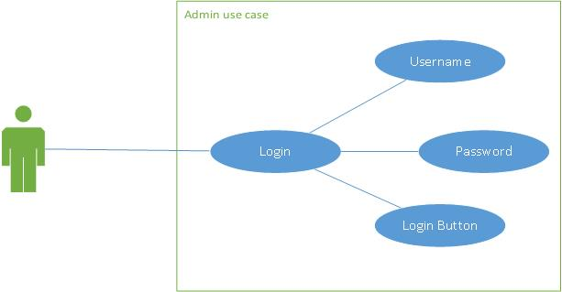
UML Modeling – admin login

Slide 26
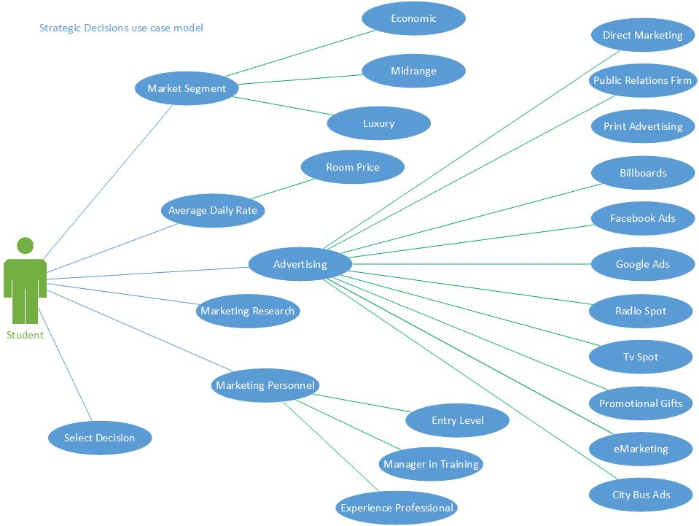
UML Modeling – Strategic Decisions

Slide 27
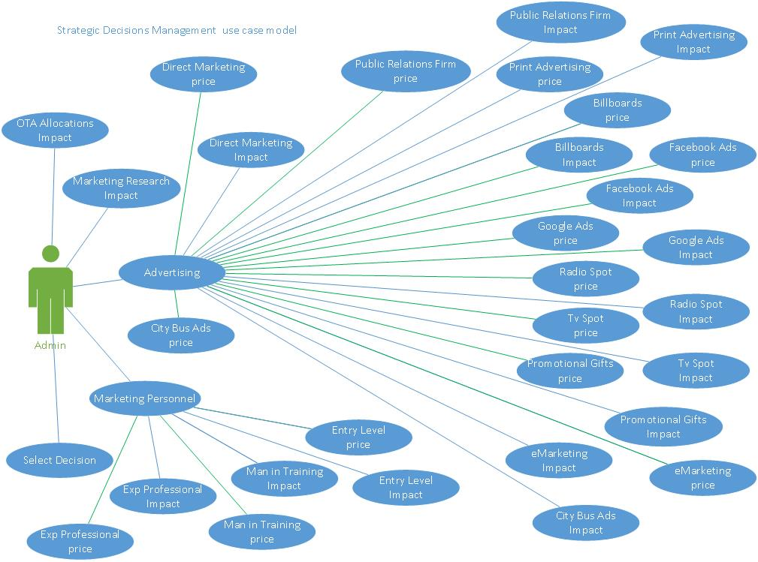
UML Modeling – Strategic Decisions Management

Slide 28
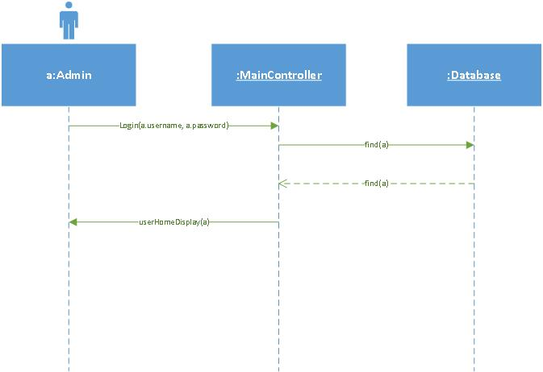
UML Modeling – Admin Login Sequence Diagram

Slide 29
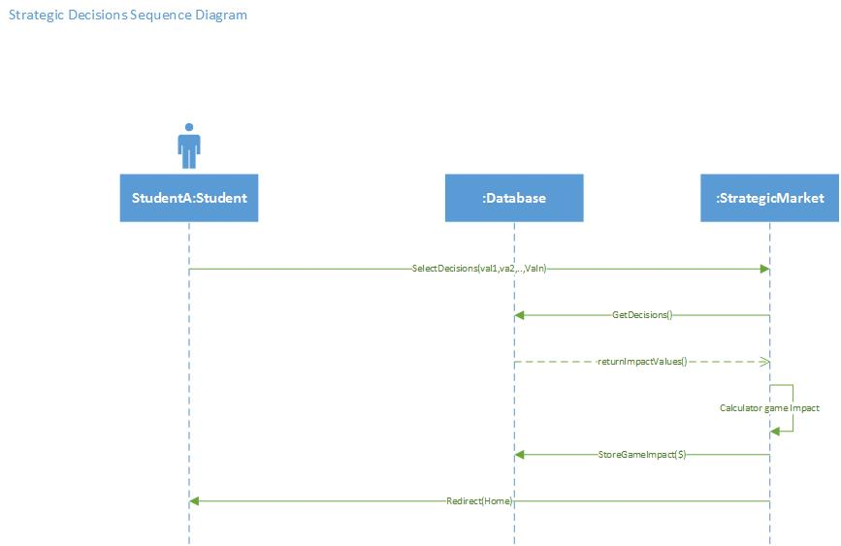
UML Modeling – Strategic Decisions Sequence Diagram

Slide 30
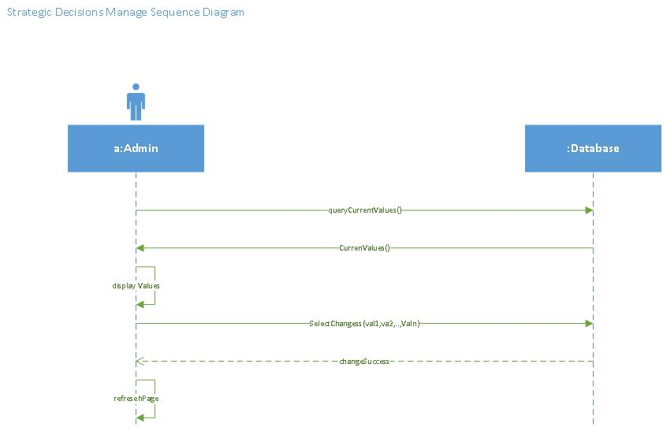
UML Modeling – Strategic Decisions Management Sequence Diagram

Slide 31
Software Testing
Example Test Case:
Test ID: | getadvertisingNameAndPriceValidTest43
Description: | Test database function getAdvertisingName with valid input
Test Steps | Step 1 : Create $id = 3
 | Step 2: create database object $db
 | Step 3: assertGreaterThan(0, $db->getAdvertisingNameAndPrice($id));
Tester: | Jeffrey Carman
Result: | Pass

Slide 32
Software Testing Output
PHPUnit 4.8.9 by Sebastian Bergmann and contributors.Runtime: PHP 5.5.9-1ubuntu4.11Configuration: /srv/marketsim/www/Tests/phpunit.xml
ok - databaseTest::test_getadvertisingNameAndPriceValid
ok - databaseTest::test_getadvertisingNameAndPriceInvalid
ok - databaseTest::test_getPersonnel
ok - databaseTest::test_getResearch
ok - databaseTest::test_getCurrentPeriod
ok - databaseTest::test_getCurrentPeriodInvald
ok - databaseTest::test_getOTA
ok - databaseTest::test_updateOTA
ok - databaseTest::test_updateOTAInvalid
ok - databaseTest::test_isDecisionTable
ok - databaseTest::test_isDecisionTableInvalid
ok - databaseTest::test_getDecisionsTableColumns
ok - databaseTest::test_getDecisionsTableColumnsInvalid
ok - databaseTest::test_getStudentDecisions
ok - databaseTest::test_getStudentDecisionsInvalid
ok - databaseTest::test_updateMarketSegment
ok - databaseTest::test_addNews
ok - databaseTest::test_addGame_period
ok - databaseTest::test_addNews_parameters
ok - databaseTest::test_getNews_by_id
ok - databaseTest::test_getNews_by_idInvalid
ok - databaseTest::test_getNews_by_game
ok - databaseTest::test_getNews_by_gameInvalid

Slide 33
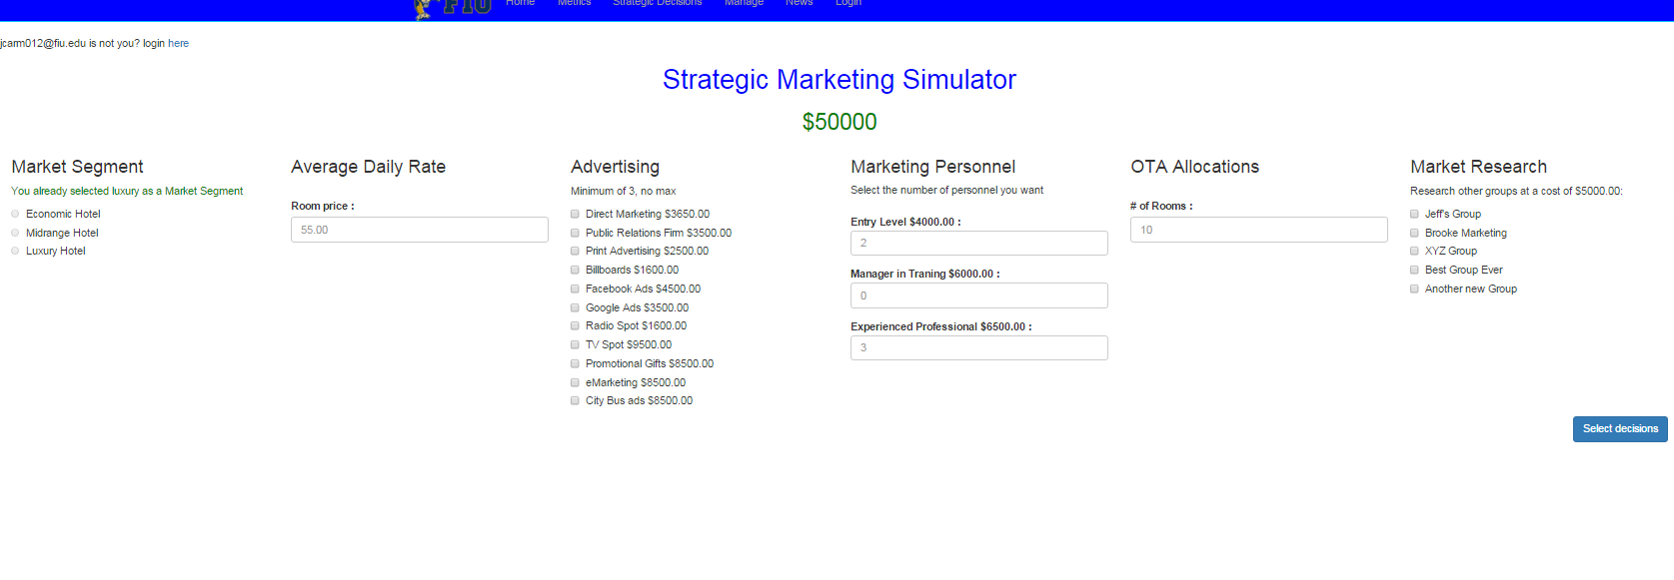
Demo

Slide 34
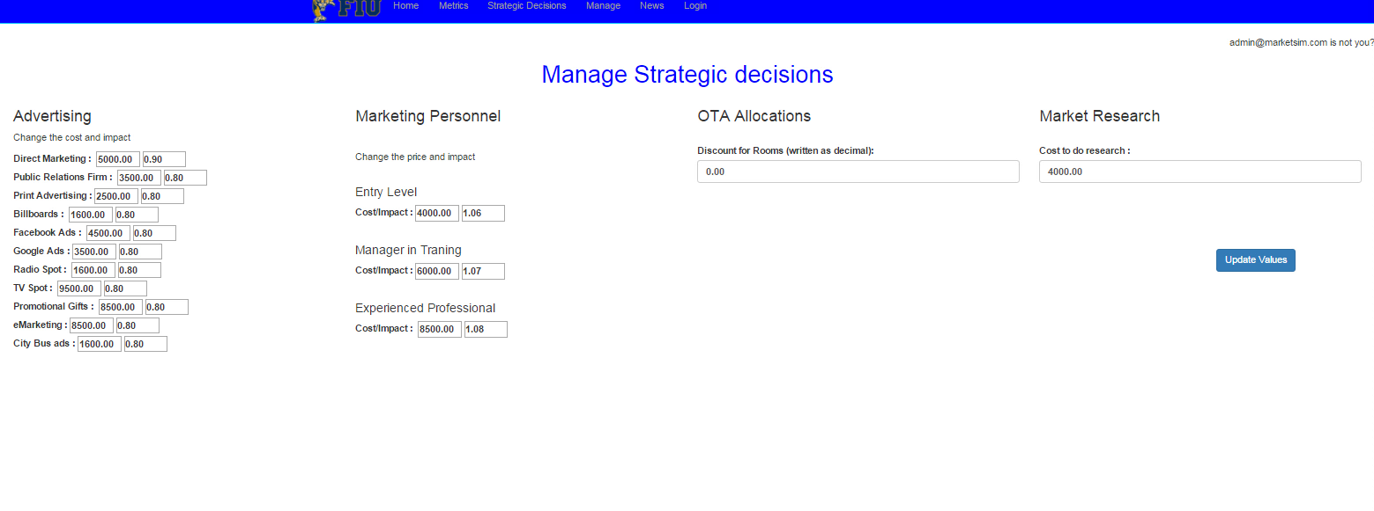
Demo

Slide 35
Strategic Marketing Simulator 1.0
Questions?

